Slide 1
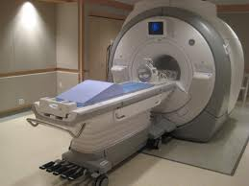
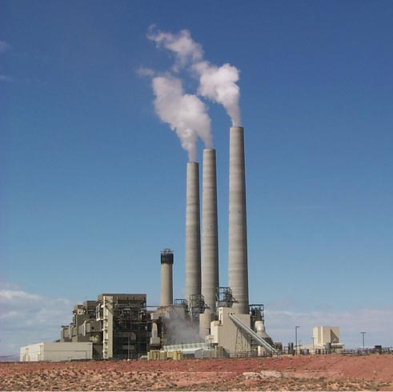



Lithium ION Battery Technology
Is Lithium Ion Battery Technology Right For You?
Presented By:
Marlene McCartha, AC & DC Power Technologies

Slide 2
Lithium ION Battery Technology- Applications
Applications Considered Today:
Station Power (Switchgear, Control Power, PV)
Uninterruptible Power Systems
+24 VDC/-48VDC Telecom
Engine Generator Start/ Centrifugal Fire Pump
Transit Switching and Signalling
Energy Storage System/ Load Levelling
Voltage Support/ Flicker Control
NMC
LFP
LTO
NCA
We will not consider consumer electronics (cell phones, hand tools, cameras, computers) or motive applications (forklifts, electric vehicles, etc.) for this presentation.
Notes:
These are the applications we will discuss in detail today. Primarily because these are the types of systems prevalent in new construction for Data Centers, Manufacturing Operations, Institutional Buildings and Process Control. What these applications have in common:
They all use primarily taper current charging systems,
They are all emergency standby applications,
They all are primarily float charging applications,
These systems are rarely cycled to a significant depth of discharge.
If I am using unfamiliar terminology, don’t hesitate to speak up.

Slide 3
Lithium ION Battery Technology- Performance
Performance Topics:
Capacity- Watt-Hours (Wh) vs. Ampere-Hour (Ah)
High Energy Density
Fast Recharge
Flat Discharge Curve
Predicted Float Life Curve (Shelf Life)
Cycle Life Vs. Float Life
Temperature Tolerance
Reliability
Safety
Notes:
These are the “Performance” factors that we will discuss today regarding the emergency standby applications.

Slide 4
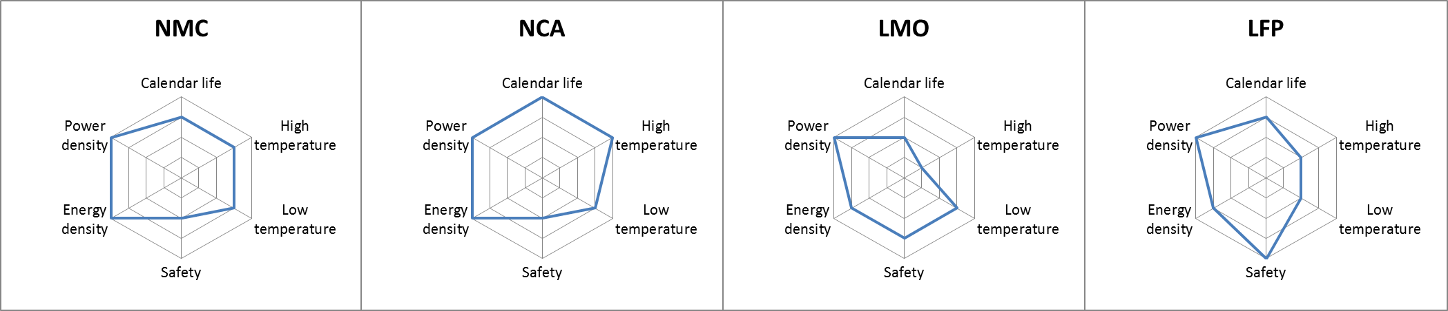
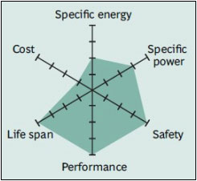
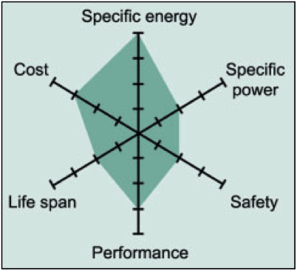
LITHIUM ION BATTERY – SPIDER GRAPH
Figure 1
LTO
LCO
Figure 2
Figure 3
Source for Figure 1 is Battcon paper by Jim McDowell. Fig 1 Fig. 2 and Fig 3 Reference: Battery University Website
Notes:
Everyone has seen these “Spider Web Graphs” that each manufacturer will produce to highlight the critical features of their products. It provides a nice self assessment and allows us to compare technologies side-by-side. As you move along the converging axis, the factor is higher as you move from the center of the graph. So if we use any one of these graphs as an example, let’s look at LMO as an example.
Calendar life at 20°C to 25°C
Calendar life at high temperature
Capacity availability at low temperature
Safety of positive active material
Energy density
Power density
Top Figures: Source Battcon Paper authored by Jim McDowell. Figure 2 and Figure 3 source is Battery University Website.

Slide 5
LITHIUM ION BATTERY – SPIDER GRAPH
Example
Feature:
Power Density: | Very High (almost off the chart)
Life: | Not very good
Hi Temp Operation: | Poor
Energy Density: | Excellent
Safety: | Excellent
Reference: Battery University Website
Notes:
Everyone has seen these “Spider Web Graphs” that each manufacturer will produce to highlight the critical features of their products. It provides a nice self assessment and allows us to compare technologies side-by-side. As you move along the converging axis, the factor is higher as you move from the center of the graph. So if we use any one of these graphs as an example, let’s look at LMO as an example.

Slide 6
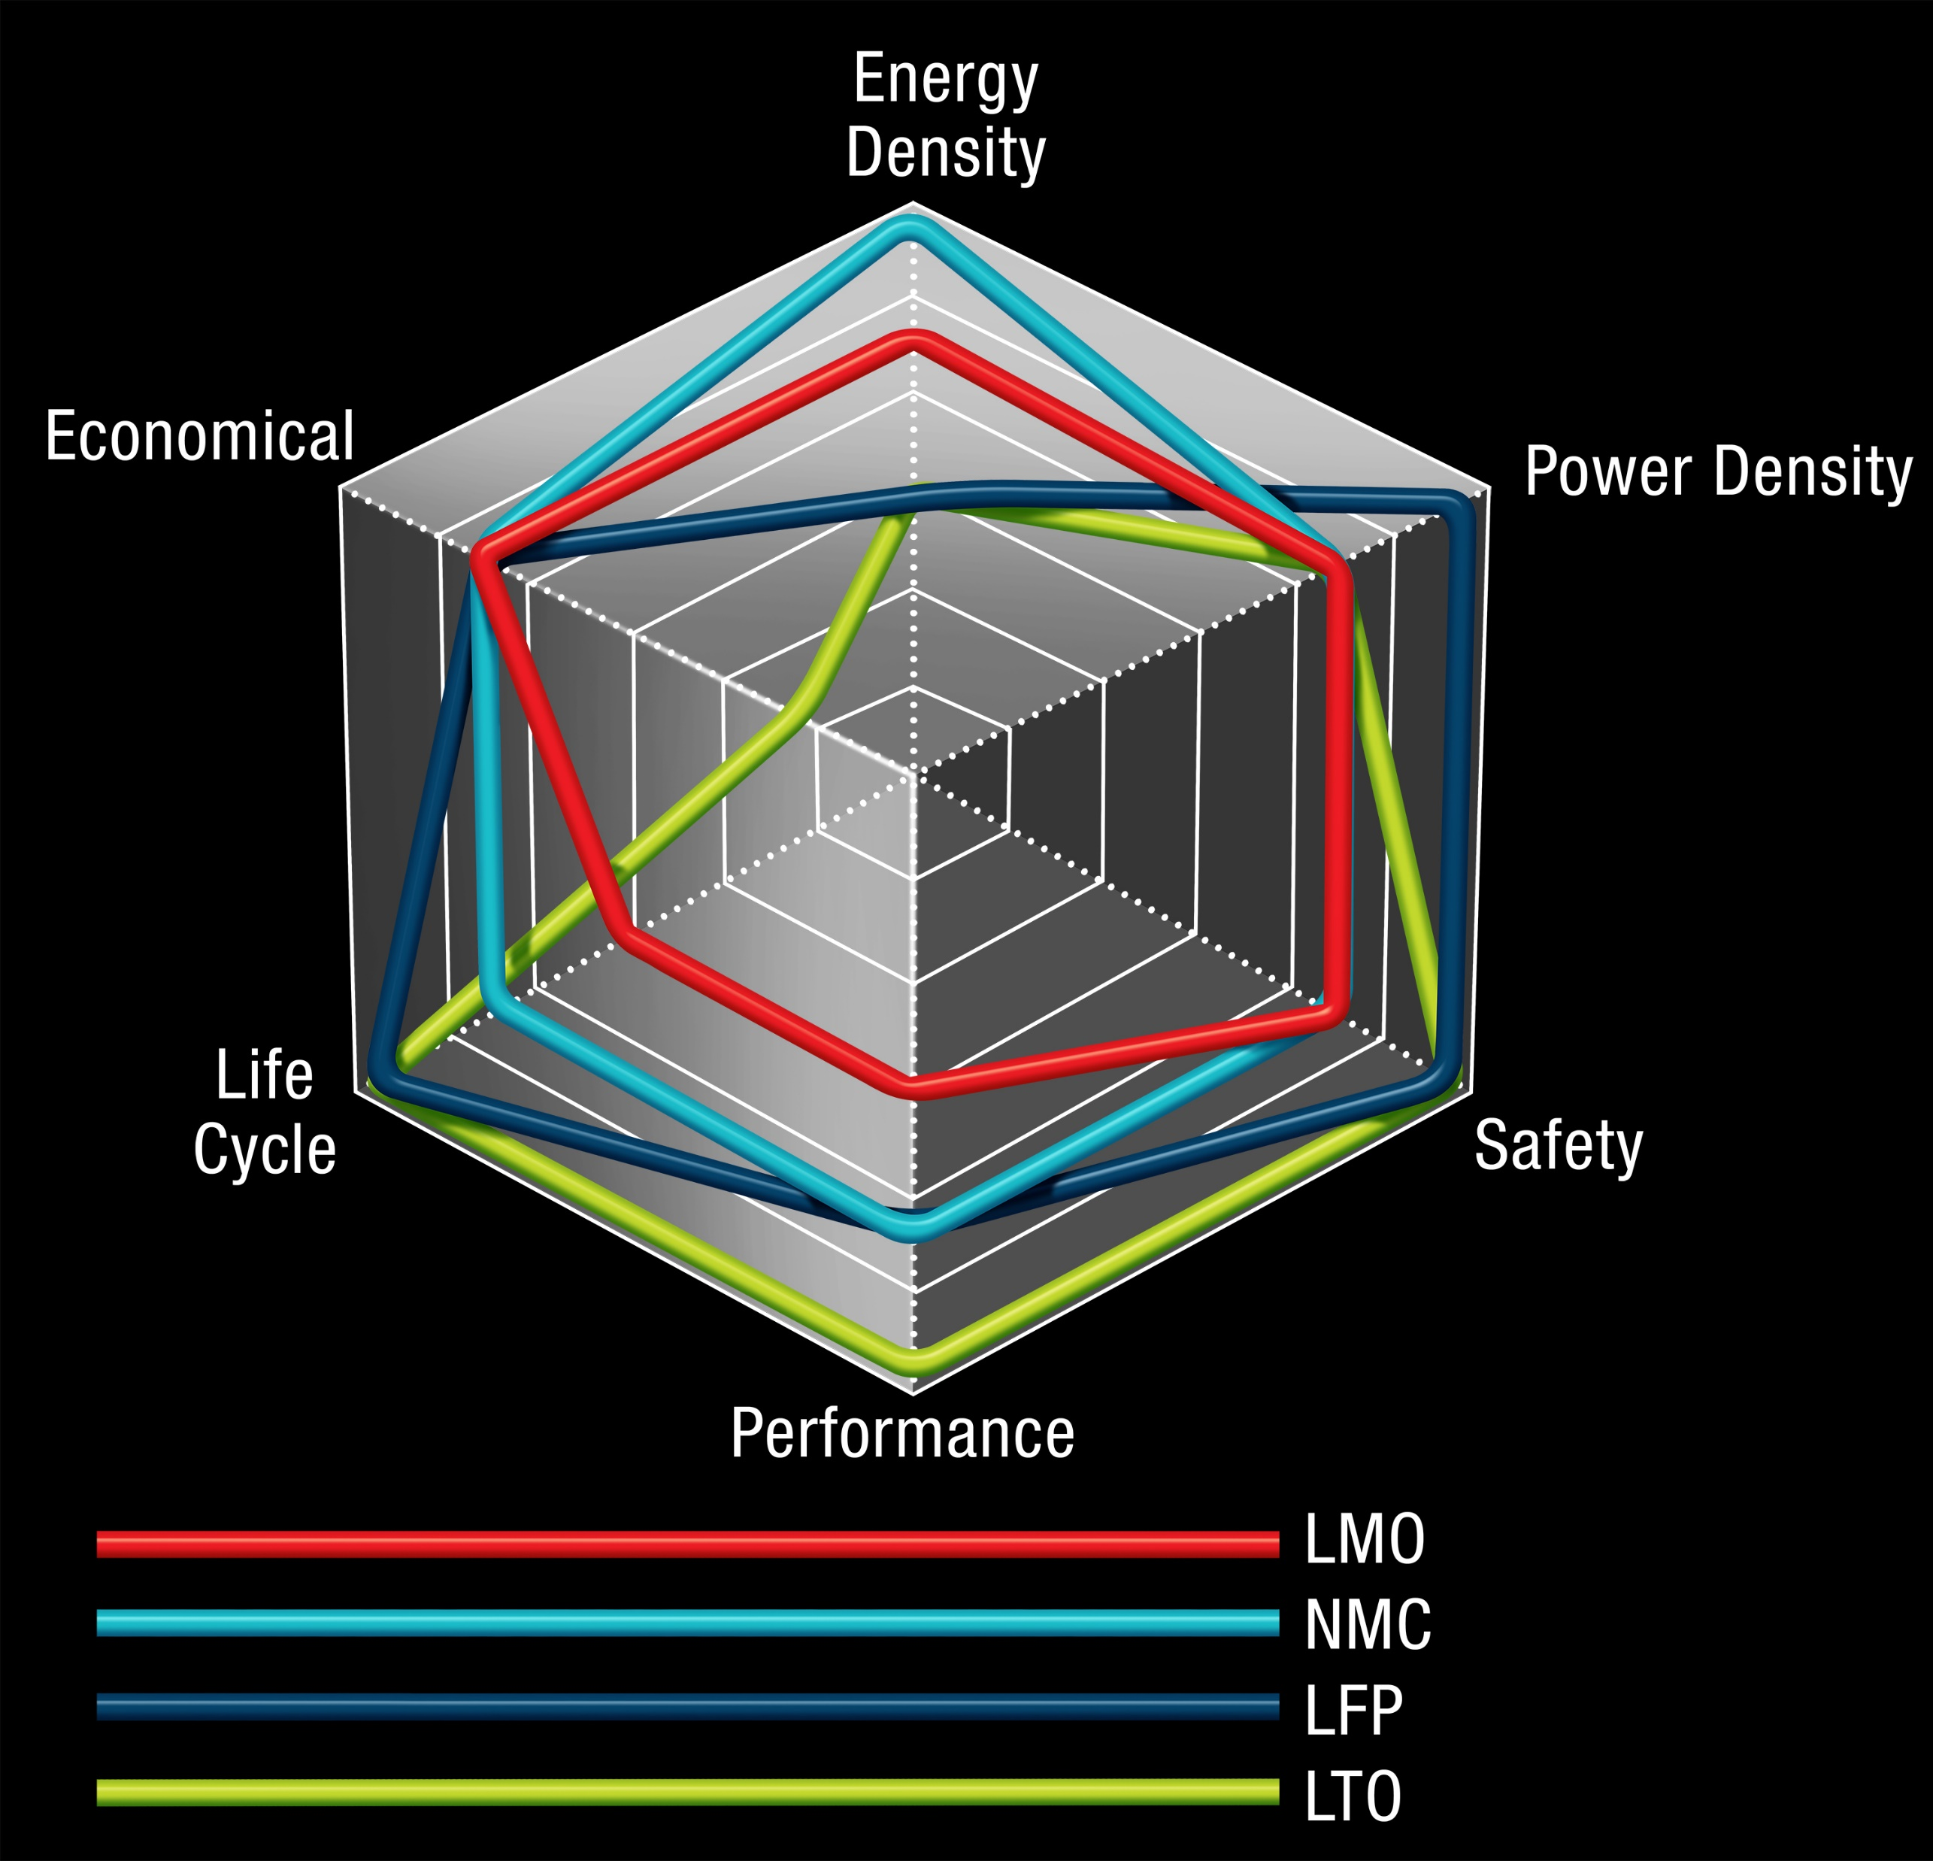
LITHIUM ION BATTERY – SPIDER GRAPH
Reference: Mitsubishi Electric Website
IEEE WG_1679-1) that is in the process of defining the criteria to be used for the comparison, selection and analysis of the electrical and safety performance criteria.
Notes:
I borrowed this slide from the Mitsubishi Electric website. This is a nice depiction of the various chemistries with performance overlayed. Each of these items is somewhat subjective and IEEE has a working group (IEEE WG_1679-1) that is in the process of defining the criteria to be used for the comparison and analysis of the electrical and safety performance criteria.

Slide 7
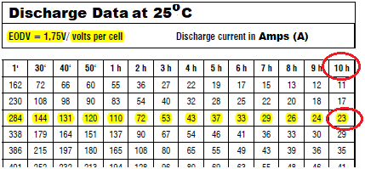
Lithium ION Battery Technology- Performance
Watt-Hours (Wh) vs. Ampere-Hour (Ah)
Discharge Time
(in hours)
Discharge Current
(in amperes)
End of Discharge Voltage
Typical lead acid battery discharge data
Notes:
Watt-hours versus Ampere-hours:
That is a topic we have to set as a foundation for the rest of the presentation.
When selecting a traditional lead acid battery, the manufacturers publish discharge data for the particular battery or cells. This data becomes the baseline data used for sizing and it depends on 4 factors:
Discharge Time
End of Discharge Voltage
Temperature
Discharge Current

Slide 8
Lithium ION Battery Technology- Performance
Ampere-Hour (Ah)
Discharge Time (in hours)
Discharge Current (in amperes)
Historically, stationary lead acid or nickel cadmium battery “nameplate” capacity has been characterized by capacity . Units of measure are in “ampere-hours”.
Formula: Discharge Time (H) x Discharge Current (A) = Capacity (Ampere-Hour)
Example: 10 (Hour) x 23 (amps) = 230 Ah
Notes:
Watt-hours versus Ampere-hours:
That is a topic we have to set as a foundation for the rest of the presentation.
Traditionally, stationary lead acid and nickel cadmium battery manufacturers used “Capacity” based on the constant current discharge to a particular cut-off voltage (end-of-discharge-voltage) to describe battery capacity. The nickel cadmium battery manufacturers selected the 5-hr discharge rate, while the lead acid battery industry typically used the 10-hour discharge rate. This is shown on the slide, that you would take the discharge table for 1.75 volt per cell end voltage, and apply the amperage for the 10-hour rate, and this would give us the “nameplate” rating or relative capacity. This was purely a relative term since the useable energy or power extracted from a battery is not linear or constant.
The slower you discharge a battery, the more useable energy you can remove from the battery. Let’s take this example on this slide. When I discharge the particular battery highlighted at the 10 hour rate, I can extract 23 amps continuously over the 10 hours before I reach an end voltage of 1.75 volts per cell. Keep in mind at this point I have not imposed any design margin, temperature derating or again factor.

Slide 9
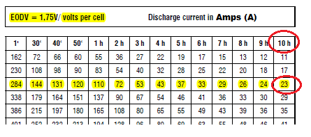
Lithium ION Battery Technology- Performance
Useable energy vs. rate of discharge
Discharge Time (in hours)
Discharge Current (in amperes)
Comparing the capacity removed at the (2) rates:
For a 30-minute discharge: 30 (min) x 1 (Hr) x 144 (amps) = 72 Ah
60 (min)
For 10-hour discharge: 10 (Hr) x 23 (amps) = 230 Ah
The slower you discharge a battery, the greater the energy delivered.
Notes:
We will use the same table from the last slide and now let’s compare the 30- minute discharge rate. From the table the the blue circle highlights the 30-minute rate, and I can extract 144 amps from this battery continuously for a full 30-minutes before reaching the end voltage of 1.75 vpc. So let’s compare the capacity removed at 30-minutes, vs. the capacity removed at 10-hours:

Slide 10
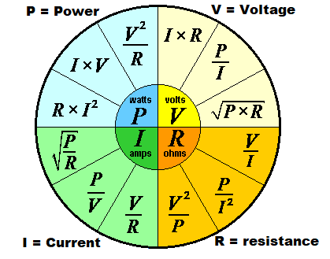
Lithium ION Battery Technology- Performance
Watt-Hours (Wh) vs. Ampere-Hour (Ah)
V x I = P
Voltage (V) x Current (A) = Power (W)
Notes:
To understand how lithium ion batteries are rated, we first have to understand the difference between energy and power.
Further, to understand the ratings for lithium ion batteries in comparison to other stationary power battery types, we will borrow from the formulas on our “Power wheel”, namely Ohms Law as it applies to linear circuits. Though battery discharge curves are not actually linear, the relationship between voltage and current is a fairly well approximated using Ohm’s Law for a given period of time.
Reference: Power wheel image from: http://www.sengpielaudio.com/calculator-ohm.htm.

Slide 11
Lithium ION Battery Technology- Performance
Watt-Hours (Wh)
Lithium ion manufacturers use “Watt-Hours” (WH) to characterize battery capacity in order to highlight energy density. We consider:
Average Voltage (Volts),
Time (Runtime in Hours),
Discharge Current (Amps)
Formula: Volts x Ampere-hours = Watt-Hours Ampere-Hour
Voltage (nominal volts) x Discharge Time (in hours) x Discharge Current (in amperes) = Wh
Example: 3.6 Volts x 42 Ah = 151 Wh
(V x I) x T = Energy Removed
Notes:
Energy Density is predominantly used to characterize the “capacity” rating for the lithium batteries, whether the application is for a stationary application, or for a UPS application.
This practice factors in the nominal discharge:
Voltage,
Time,
Current.

Slide 12
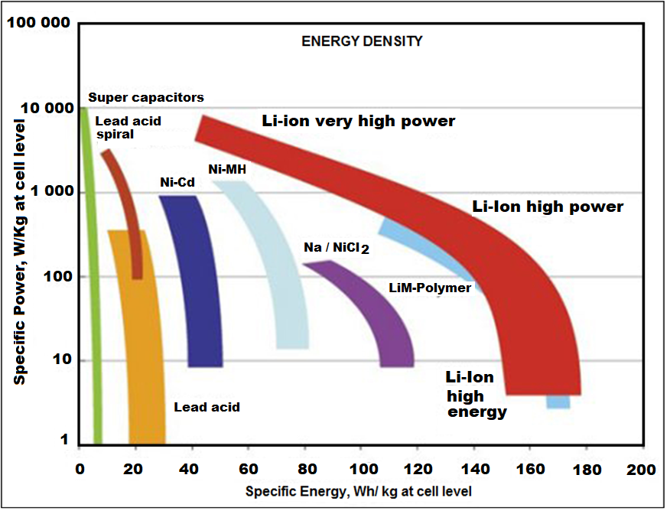
Lithium ION Battery Technology - Energy Density

Slide 13
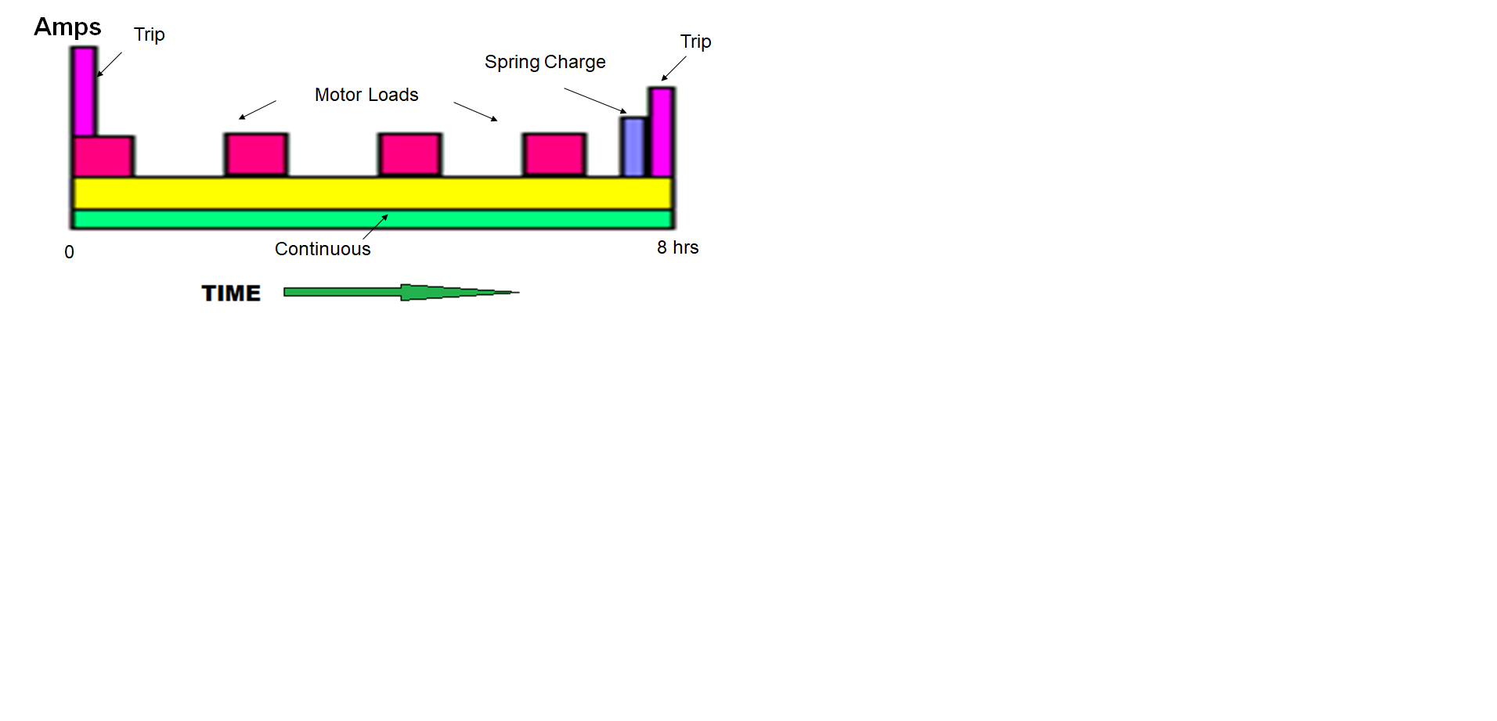
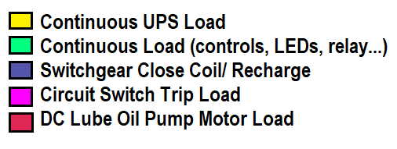
GENERATION PLANT Load Profile- 240 VDC

Slide 14

Generation Plant Example- 240VDC (50KW 8 Hours)
Raw Material | Price per Pound (US$)
Titanate Oxide | $25.70
Cobalt Oxide | $14.52
Lithium Carbonate | $7.36
Nickel | $5.60
Lead (New) | $0.92
Lead (Scrap) | $0.75
?? = transparency
Notes:
Before we compare the pricing of these different systems, I thought it might be helpful to put into perspective the heaviest weighted material pricing in the different batteries we are going to discuss today. Wallstreet Journal is reporting that the LME is reported to be rolling out an “exchange traded contract” for lithium in 2019.
Reference: LME 2/17/2019 for lead and cobalt pricing. Lithium trending courtesy of Wallstreet Journal Nov. 27th, 2018, “Lithium Boom Raises Question: What is Its Price?” Lithium metals pricing based on article s1.q4cdn.com/337451660/files/doc_articles/2016/161214-Benchmark Minerals Intelligence and Fastmarkets-approved-for-distribution “Lithium-ion Supply Chain.pdf”.
Nickel pricing is dominated by the stainless steel industry of which China is currently the largest user. Cobalt Oxide pricing is dominated by the Chinese EV market. 46% of the world market for lithium goes to EV market. Today, Australia, Chile, Argentina, China, Zimbabwe are the world’s largest producers…the USA is the 8th largest producer.

Slide 15
Generation Plant Example- 240VDC (50KW 8 Hours)
50KWB GENERATION PLANT UPS APPLICATION
Battery Type | Cost | Battery Type | Cost
Flooded Pb Calcium Faure’ | $165,600 | VR Pb antimony Gel Faure’ | $384,200
Flooded Pb antimony Faure’ | $162,680 | Flooded VR Nicad | $212,689
Flooded Plante’ | $179,500 | Flooded Nicad Pocket plate | $205,564
Flooded Pb Selenium | $135,360
Flooded lead antimony tubular | $160,720 | Flooded NicadPBE | $256,556
VRLA calcium | $184,024 | Flooded Nicad Fiber | $233,073
Lithium LFP | $288,000
Lithium Titanate | $252,000
Notes:
Pricing established here is based on batteries that are commonly quoted for this type of application. Note that no accessories are included in these figures, strictly batteries and standard non-seismic racking, except for the Lithium Titanate which is in cabinets.

Slide 16
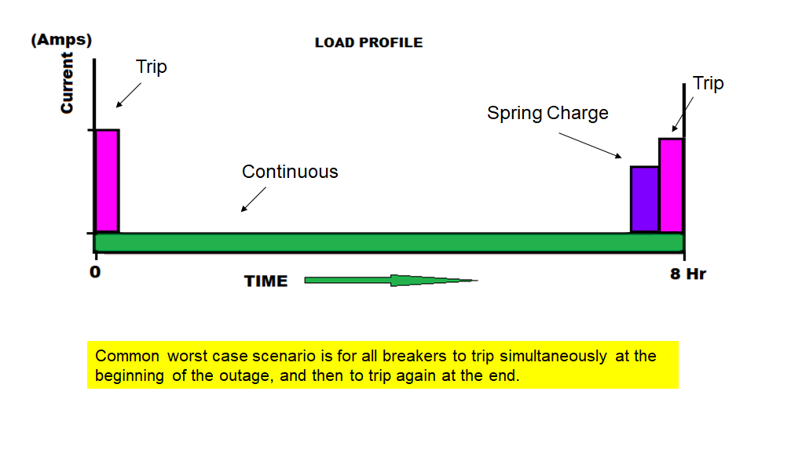
SUBSTATION Switchgear Load Profile- 120 VDC

Slide 17
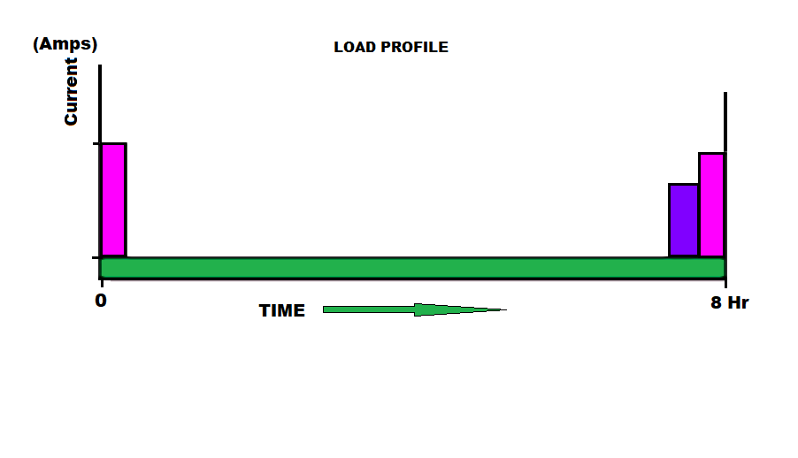
Substation Example- 120VDC
Notes:
This pricing is based on the following:
No end of life aging factor
No temperature derating
No DC landing/Distribution
No design margin
No seismic adder for bracing.

Slide 18
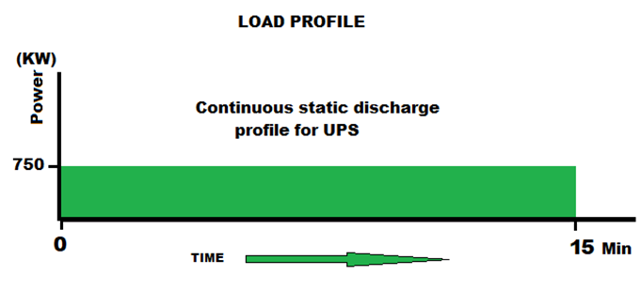
DATA CENTER UPS Load Profile- 480 VDC
15 Min
5 Min
Notes:
Typical Data Center UPS loads are constant power for the duration of the discharge as the load profile on this slide suggests. The (2) graphs below show the red line for current, and the blue line for voltage from time = 0 on the x-axis to time = 5 minutes, or 15 minutes. Note that there is no Coup de Fouet as the load starts.
We ran a couple of examples of lithium ion technologies to compare pricing footprint, floor loading and pricing. So we chose 5 minutes and 15 minutes for comparison sake.

Slide 19
Lithium Ion Battery- 480V 750kWB 15-Min UPS
UPS APPLICATION 480VDC 15 Minute Battery @ 750KWB
Technology | # of Strings | # of Cabinets | Length (In) | Width (In) | Height (In) | Total Weight (lbs) | Cost
Flooded NICAD | 1 | 2+2T Racks | 1490 | 25 | 76 | 46,800 | $390,000
VLA Calcium | 1 | 3T Racks | 510 | 35 | 78 | 59,916 | $225,000
VLA Selenium | 1 | 2+2T Racks | 570 | 32 | 82 | 70,640 | $258,000
VRLA (10-Yr) | 6 | 6 | 240 | 29.5 | 78.7 | 29,266 | $98,266
Lithium NMC | 20 | 20 | 446 | 27.2 | 92.1 | 28,020 | $205,000
Lithium LFP | 12 | 12 | 288 | 20.5 | 84 | 10,440 | $214,800

Slide 20
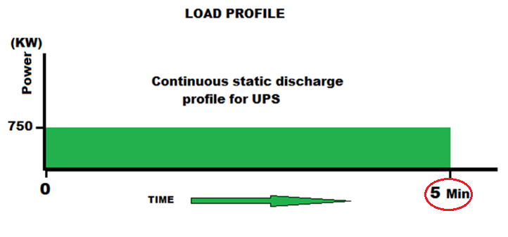
Lithium Ion Battery- 480V 750kWB 15-Min UPS
UPS APPLICATION 480VDC 5 Minute Battery @ 750KWB
Technology | # of Str | # of Cab | Length (In) | Width (In) | Height (In) | Total Weight (lbs) | Cost
Flooded NICAD | 1 | 2+2 Racks | 1490 | 25.0 | 76.0 | 46,800 | $241,000
VLA Calcium | 1 | 3T Racks | 816 | 32 | 78 | $42,528 | $153,360
VLA Selenium | 1 | 2+2 Racks | 570 | 32 | 78 | 45,360 | $178,320
VRLA (10-Yr) | 4 | 4 | 160 | 29.5 | 78.7 | 19,004 | $66,250
Lithium LTO | 16 | 8 | 273 | 34.1 | 80.7 | 15,360 | $311,900
Lithium LFP | 6 | 6 | 144 | 20.5 | 84.0 | 5,220 | $107,400
Notes:
-

Slide 21
Lithium Ion Battery- Electrode Configuration
Station Battery Technology | Chemistry | Electrode Construction
LTO Lithium Titanate Oxide | Li₄Ti₅O₁₂ / 6LiCoO₂ | Prismatic
LFP Lithium Iron Phospate (LFP/LiFePO4) | LiFePO4 / LiC₅ | Cylindrical Jelly-roll
SLFP Super Lithium Iron Phosphate (LFP / LiFePO4 +NCA | LiFePO4 + LiNiCoAlO2 / LiC₅ | Cylindrical Jelly-roll
NCA Lithium Nickel Cobalt Aluminum Oxide | LiNiCoAlO2 (9% Co) | Cylindrical Jelly-roll
NMC Lithium Nickel Manganese Cobalt Oxide | LiNiMnCoO2 | Cylindrical Jelly-roll
Does cell construction matter for the end-user?
Notes:
We won’t talk at all about the lithium cobalt oxide or LCO that is really high power density used for cell phones, cameras, and laptops.
In fact the three most prevalent chemistries we will discuss have to do with the LTO, LFP, NMC and NCA. All of these chemistries use lithium in an organic solvent typical of LiPF6.
There are some differences in performance that do appear to be related to the cell configuration as we will see on the next slides

Slide 22
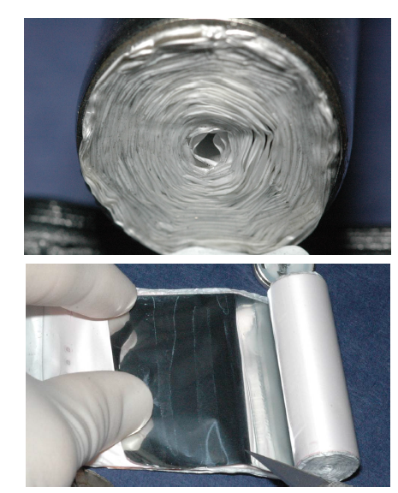
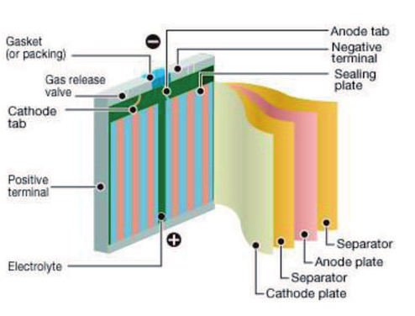
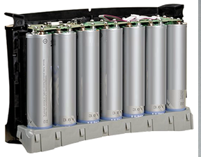
Lithium Ion Battery- Electrode Configuration
Cylindrical Cell
Fig 1
Fig 2
Fig 3
Benefits:
Good heat dissipation
Best for high temperature mgmt
Flexible form factor
Lower cost
Fig 4
Does cell construction matter for the end-user?
Notes:
Figure 1 and 2; Reference “Recovery of Electrodic Powder from Spent Lithium Ion Batteries (LIBs)”, authors: S.M. Shin, G.J. Jung, Woo-Jin Lee, C.Y. Kang, J. P. Wangg ARCHIVES OF METALLURGY AND MATERIALS Volume 60 2015 Issue 2 DOI: 10.1515/amm-2015-0086
Figure 3, courtesy of Saft
Lithium dissolved in organic solvent is the electrolyte for most LION batteries. Additional reference for cylindrical cell photos: Table 1. from Measured flash points auto-ignition temperatures, and heats of combustion of some typical lithium-ion cell organic electrolyte components. Reference: Lithium-Ion Batteries Hazard and Use Assessment Final Report
Prepared by: Celina Mikolajczak, PE, Michael Kahn, PhD, Kevin White, PhD, Richard Thomas Long, PE
Exponent Failure Analysis Associates, Inc.

Slide 23
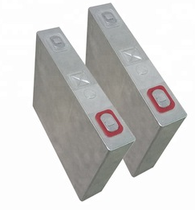
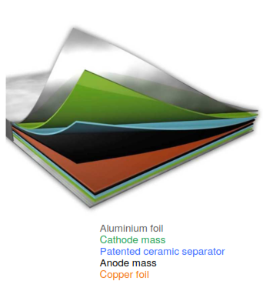
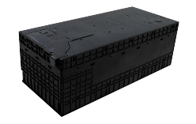
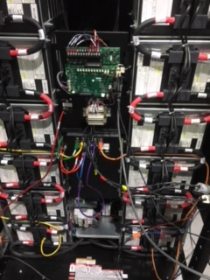
Lithium Ion Battery- Electrode Configuration
Prismatic Cell
Benefits:
Good heat dissipation
Flexible form factor
Super-fast charging
Less SEI Interface growth with low temp charging
Less Lithium plating during cycling
Cell
Module
Does cell construction matter for the end-user?
Notes:
Figure 2; Reference “Recovery of Electrodic Powder from Spent Lithium Ion Batteries (LIBs)”, authors: S.M. Shin, G.J. Jung, Woo-Jin Lee, C.Y. Kang, J. P. Wangg ARCHIVES OF METALLURGY AND MATERIALS Volume 60 2015 Issue 2 DOI: 10.1515/amm-2015-0086
Lithium dissolved in organic solvent is the electrolyte for most LION batteries.
Electrode stack photo courtesy of Leclanche’ Energy Storage Solutions.

Slide 24
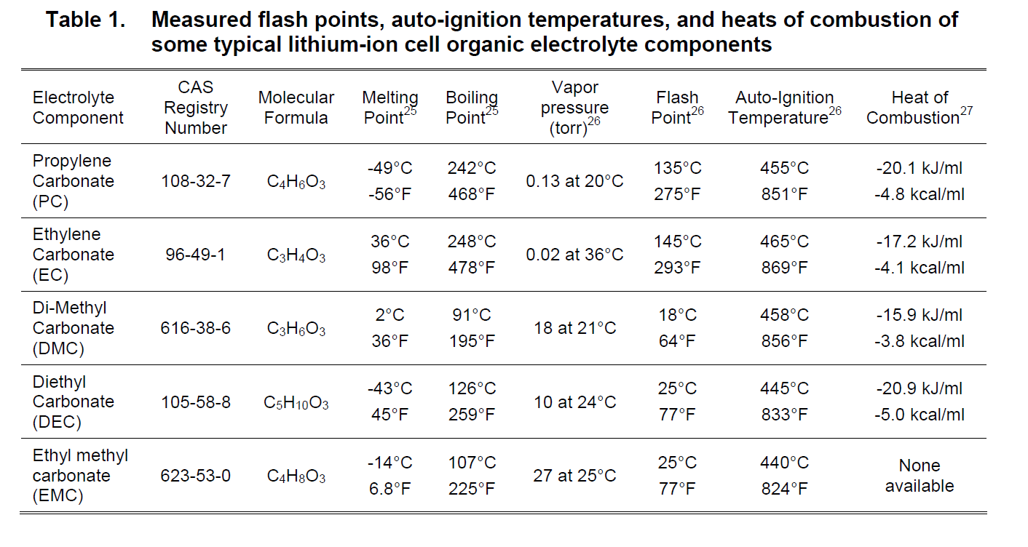
Lithium Battery Training- Electrolyte
IFC 2018 hapter 12 and NFPA-1 chapter 52 FLASHPOINTS FOR VARIOUS LITHIUM ION ELECTROLYTES
Notes:
Organic solvents and dissolved lithium salts are the composition of the electrolytes used in LION batteries. I was curious about the flash points of the common electrolytes used by the standby power lithium products. That is when I came across the table above. The curious thing, is how low the flash point is for many of these organic solvents. …in particular the Ethyl carbonate, Di-Methyl carbonate and the Ethyl Methyl carbonate…….near or below typical room temperatures. Per Wikipedia: The flash point is the lowest temperature at which a particular organic compound gives of sufficient vapor to ignite in air
Table 1. from Measured flash points auto-ignition temperatures, and heats of combustion of some typical lithium-ion cell organic electrolyte components. Reference: Lithium-Ion Batteries Hazard and Use Assessment Final Report
Prepared by: Celina Mikolajczak, PE, Michael Kahn, PhD, Kevin White, PhD, Richard Thomas Long, PE
Exponent Failure Analysis Associates, Inc. July 2011

Slide 25
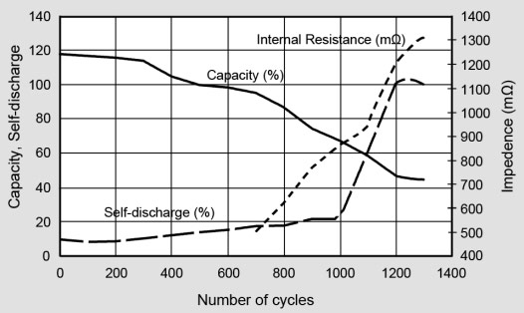
Cycle Life- Nickel Cadmium Pocket Plate

Slide 26
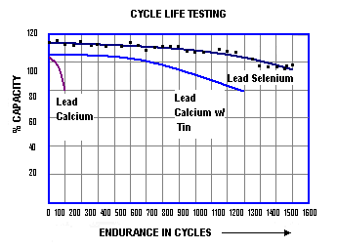
Lead Acid Grid Alloys- Cycle Life

Slide 27
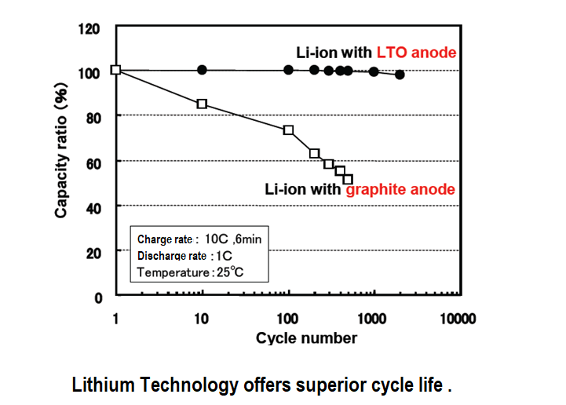
LITHIUM ION BATTERY – Cycle Life

Slide 28
BATTERY TRAINING- Best Practice Standards
Sizing Guidelines | Lead Acid | Nickel Cadmium | Lithium Ion
IEEE Sizing (Standby, station power, and UPS) | IEEE 485 | IEEE 1115 | None Available
NFPA Sizing (Engine Starting Emergency Gensets Centrifugal Fire Pumps) | NFPA99 NFPA110 NFPA20 | NFPA99 NFPA110 NFPA20 | NFPA99 NFPA110 NFPA20
Maintenance & Test Guidelines | IEEE 450 (flooded) IEEE 1188 (VRLA) | IEEE 1106 | IEEE 2030.2.1 (BESS)
Fire Protection | NFPA 52.3.2.7-8 NFPA 850 Chapter 4 | NFPA 52.3.2.7-8 NFPA 850 Chapter 4 | NFPA 52.3.2.7-8 NFPA 850 Chapter 4
Notes:
Fire suppression system can consist of neutral gas extinguishers (for example Argonite, Nitrogen, Novec 1230, etc.,) or water sprinklers.
Suppression:
2015 editions did not explicitly required suppression
2018 required for all battery spaced w/ exceptions for telecommunication installations
Gas Detection
Alarming for 25% of the lower flammability level of gas as well as 50% of the IDLH (immediately dangerous to life or health) for toxic or highly toxic gases.
Must have visible and audible alarms in the battery room
Approved transmission to specific location
De-energizing of the battery rectified
Activation of the ventilation

Slide 29
Lithium Ion Battery- Operating Temperatures Comparison
Stationary Battery Type: | Operating Voltage (per cell) | Specific Energy (Wh/Kg) | Operating Temperature | Cycle Life (to80% DOD)
Nickel Cadmium Pocket Plate | 1.2 | 40 | -40C to 50C (-40⁰F to 122⁰F) | >1500
Nickel Cadmium PBE | 1.2 | 60 | -20C to 50C (-4⁰F to 122⁰F) | >2000
VR Lead Acid (Pure lead grid) | 2.0 | 30-50 | -40C to 50C (-40⁰F to 122⁰F) | >500
VR Lead Acid (Ca) | 2.0 | 30-50 | 30C to 50C* (-22⁰F to 122⁰F) | >300
Flooded Lead Acid (Ca) | 2.0 | 30-50 | 0C to 49C (32⁰F to 120⁰F) | <100
Flooded Lead Selenium | 2.0 | 33 - 42 | -20C to 55C (-4⁰F to 131⁰F) | 800 - 1000
LTO (NMC cathode, LiTO anode) | 2.3 | 60 - 110 | 0C to 40C (32⁰F to 104⁰F) (average over 24hr period 41-95⁰F) | >10000
SLFP+NCA | 3.7 | 90-120 | -40C to 50C (-40⁰F to 122⁰F) | 7000
LFP Lithium Iron Phoshpate (LiFePO4) | 3.2 | 90 - 110 | -20C to 60C (-4⁰F to 122⁰F) | >2000
NCA (Lithium Nickel Cobalt Al Oxide) (LiNiCoAlO2 | 3.6 | 200-260 | -40C to 75C (-40⁰F to 167⁰F) | 4300
We took the same chart from the previous slide, but reproduced it based on the stationary power applications.
Again, the source used were averages from OEM manuals.
VRLA Batteries must not be charged above 90 deg F, or below 32 deg F.
Notes:
Notes:
Special care should be taken when trying to research the technology best suited for your applications. Much of the data produced is based on laboratory findings, or on applications/products not specifically used for station power and/or UPS applications. Data from widely reputable sources can be very misleading. The data presented here comes straight from either the warranty statement or from the Safety Data Sheet for each of the most predominant manufacturers of station battery power.

Slide 30
Lithium Ion Battery- Specific Energy Comparison
Stationary Battery Type: | Operating Voltage (per cell) | Specific Energy (Wh/Kg) | Operating Temperature | Cycle Life (to80% DOD)
Nickel Cadmium Pocket Plate | 1.2 | 40 | -40C to 50C (-40⁰F to 122⁰F) | >1500
Nickel Cadmium PBE | 1.2 | 60 | -20C to 50C (-4⁰F to 122⁰F) | >2000
VR Lead Acid (Pure lead grid) | 2.0 | 30-50 | -40C to 50C (-40⁰F to 122⁰F) | >500
VR Lead Acid (Ca) | 2.0 | 30-50 | 30C to 50C* (-22⁰F to 122⁰F) | >300
Flooded Lead Acid (Ca) | 2.0 | 30-50 | 0C to 49C (32⁰F to 120⁰F) | <100
Flooded Lead Selenium | 2.0 | 33 - 42 | -20C to 55C (-4⁰F to 131⁰F) | 800 - 1000
LTIO (NMC cathode, LiTO anode) | 2.3 | 60 - 110 | 0C to 40C (32⁰F to 104⁰F) (average over 24hr period 41-95⁰F) | >10000
Super Lithium Iron Phosphate (LFP / LiFePO4 +NCA) | 3.7 | 90-120 | -40C to 50C (-40⁰F to 122⁰F) | 7000
LFP Lithium Iron Phospate (LFP/LiFePO4) | 3.2 | 90 - 110 | -20C to 60C (-4⁰F to 122⁰F) | >2000
Lithium Nickel Cobalt Al (LiNiCoAlO2/NCA) | 3.6 | 200-260 | -40C to 75C (-40⁰F to 167⁰F) | 4300
We took the same chart from the previous slide, but reproduced it based on the stationary power applications.
Again, the source used were averages from OEM manuals.

Slide 31
Lithium Ion Battery- Cycle Life Comparison
Stationary Battery Type: | Operating Voltage (per cell) | Specific Energy (Wh/Kg) | Operating Temperature | Cycle Life (to80% DOD)
Nickel Cadmium Pocket Plate | 1.2 | 40 | -40C to 50C (-40⁰F to 122⁰F) | >1500
Nickel Cadmium PBE | 1.2 | 60 | -20C to 50C (-4⁰F to 122⁰F) | >2000
VR Lead Acid (Pure lead grid) | 2.0 | 30-50 | -40C to 50C (-40⁰F to 122⁰F) | >500
VR Lead Acid (Ca) | 2.0 | 30-50 | 30C to 50C* (-22⁰F to 122⁰F) | >300
Flooded Lead Acid (Ca) | 2.0 | 30-50 | 0C to 49C (32⁰F to 120⁰F) | <100
Flooded Lead Selenium | 2.0 | 33 - 42 | -20C to 55C (-4⁰F to 131⁰F) | 800 - 1000
LTIO (NMC cathode, LiTO anode) | 2.3 | 60 - 110 | 0C to 40C (32⁰F to 104⁰F) (average over 24hr period 41-95⁰F) | >10000
Super Lithium Iron Phosphate (SLFP / LiFePO4 +NCA) | 3.7 | 90-120 | -40C to 50C (-40⁰F to 122⁰F) | 7000
Lithium Iron Phoshpate (LFP/LiFePO4) | 3.2 | 90 - 110 | -20C to 60C (-4⁰F to 122⁰F) | >2000
Lithium Nickel Cobalt Al (NCA) | 3.6 | 2.1 kWhr | -40C to 75C (-40⁰F to 167⁰F) | 4300
We took the same chart from the previous slide, but reproduced it based on the stationary power applications.
Again, the source used were averages from OEM manuals.
VRLA Batteries must not be charged above 90 deg F, or below 32 deg F.

Slide 32
Lithium Ion Battery- Storage Comparison
Stationary Battery Type: | Self Discharge Rate | Shelf Life | Relative Humidity | Storage Temperature
Nickel Cadmium Pocket Plate | 1.2 | 5 Years |  | -40C to 50C (-40⁰F to 122⁰F)
Nickel Cadmium PBE | 1.2 | 2 Years |  | -20C to 50C (-4⁰F to 122⁰F)
VR Lead Acid (Pure lead) | 2.0 | 2 Years |  | -40C to 50C (-40⁰F to 122⁰F)
VR Lead Acid (Ca)* | 2.0 | 6-Mo* |  | 30C to 50C* (-22⁰F to 122⁰F)
Flooded Lead Acid (Ca) | 2.0 | 1 Year |  | 0C to 49C (32⁰F to 120⁰F)
Flooded Lead Selenium | 2.0 | 1 Year |  | -20C to 55C (-4⁰F to 131⁰F)
LTIO (NMC cathode, LiTO anode) | 2.3 | 15 Year | 30 – 90% (non-condensing) | 0C to 40C (32⁰F to 104⁰F) (average over 24hr period 41-95⁰F)
LFP+NCA | 3.7 | 12-15 |  | -40C to 50C (-40⁰F to 122⁰F)
Lithium Iron Phoshpate (LFP/LiFePO4) | 3.2 | N/A |  | -20C to 60C (-4⁰F to 122⁰F)
Lithium Nickel Cobalt Al(NCA) (LiNiCoAlO2/NCA) | 3.4 | 10 -20 |  | -40C to 75C (-40⁰F to 167⁰F)

Slide 33
Lithium ION Battery Technology- Limitations
Special Considerations:
Humidity (Operational and Storage)
Storage Limitations
Code Enforced Allowable Quantities
Clearance for Fire Code Requirement
Shipping
Proprietary Software for BMS
Cost
Best value for short duration discharges

Slide 34
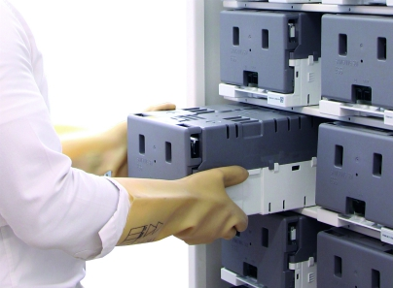
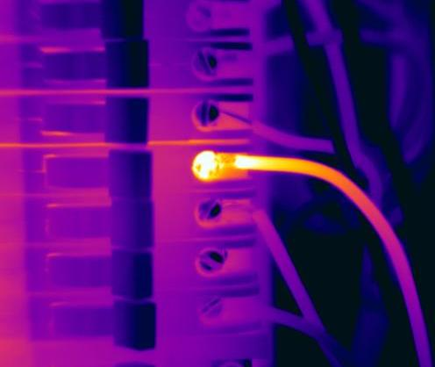
Lithium ION Battery Technology- Maintenance
Maintenance Requirements: IEEE 2030.2.1 (BESS)
Vacuum/ Clean cells/cabinet
Check/Adjust torque
Download data from BMS
Thermal scan connections and cells
Flash calibration/firmware if required
Must meet UL 1642.5 for technician replaceable modules.
Source: IEEE 2030.2.1
Notes:
Photo courtesy of Vertiv Website and FlirT2000 training presentation.
Information regarding the required maintenance was derived from the IEEE 2030.2.1.
Note that UL 1642 is an exact copy of IEC 62133

Slide 35
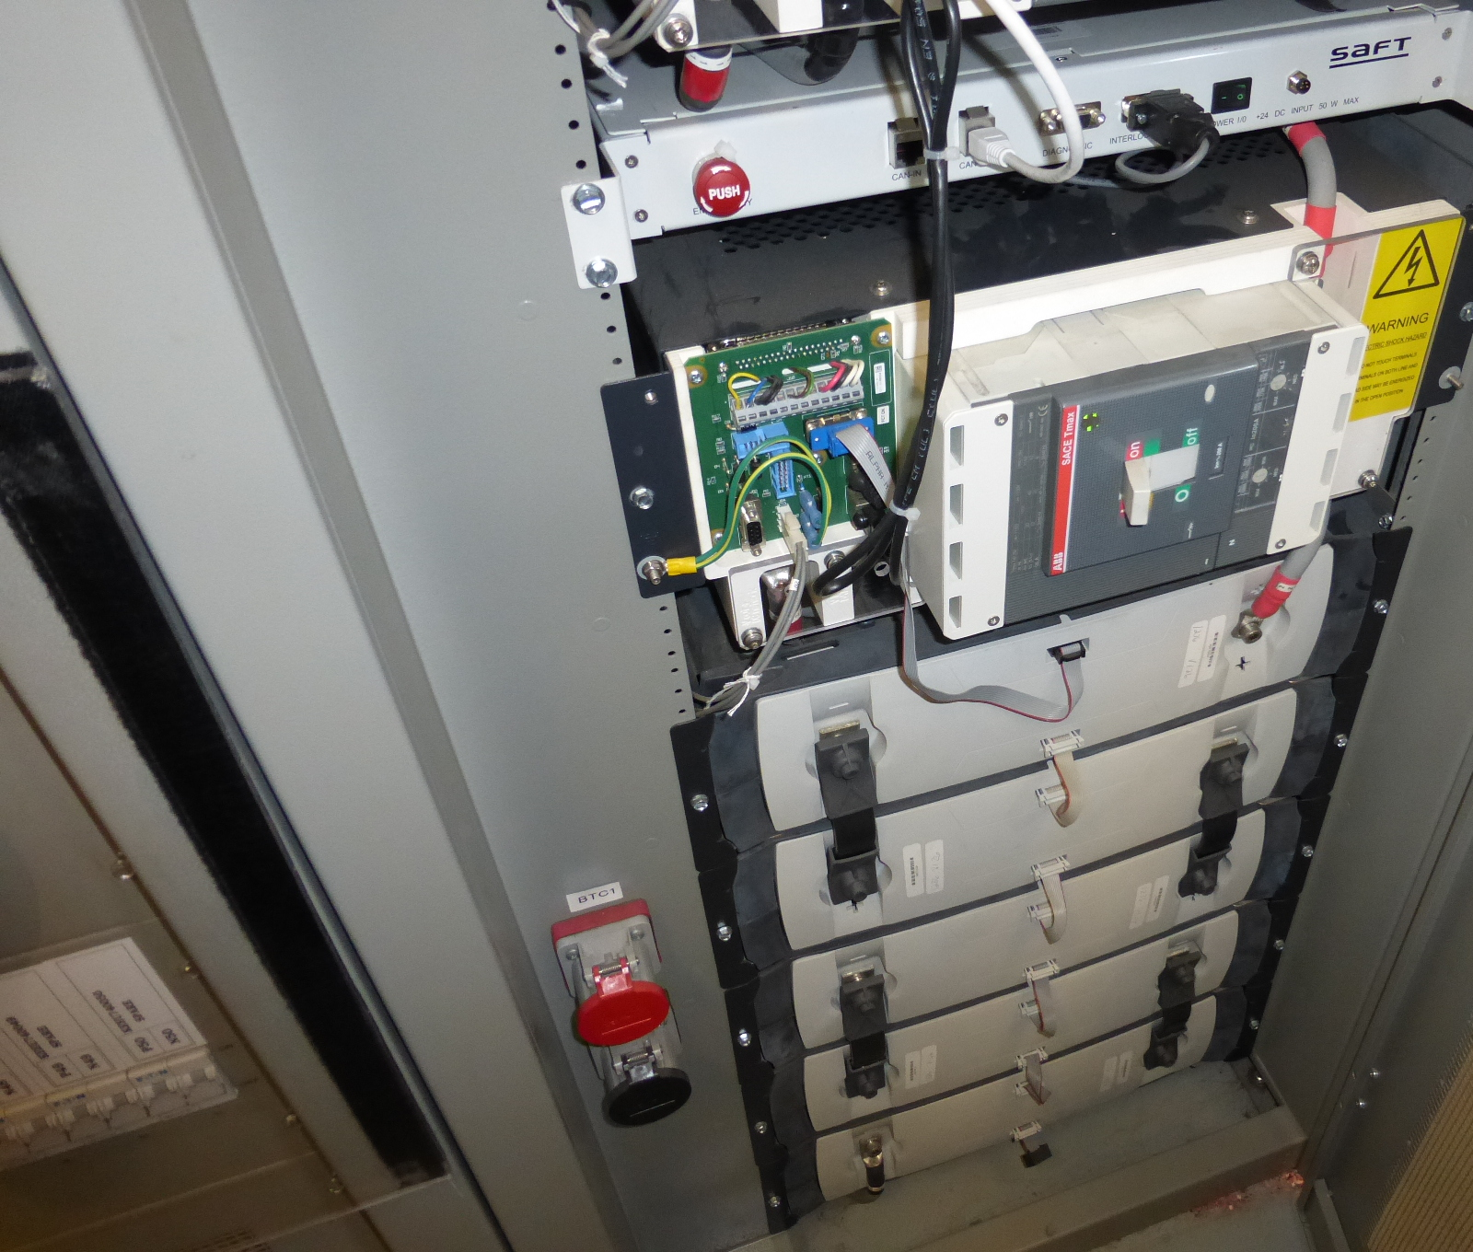
Lithium ION Battery Technology- Safety
How Safe are these LION systems:
Monitoring makes the difference. | Each cell is monitored for: Voltage, Temperature, Current.
 | Each string is monitored for: Reverse Polarity Protection, Impedance, Voltage, Temperature, Current.
Controls provide additional safety. | Hardened electronics/PLC
 | Thermal Runaway Control (55ºC alarm/ 65ºC disconnect)
 | Cell Balancing
 | CANBUS for Local and Remote Communication
 | Each cell and string has the ability to be removed from the DC bus without impacting operation of the others (cell-level disconnecting means)
Notes:
If communication is lost between modules, the string is disconnected from the system. This will not impact the system if it is configured as N+1…..It will affect the runtime of the system IF it is not N+1 or higher for redundancy.
The Lithium ion batteries are designed to be very stable for float charge and taper current charge applications with the thermal runaway temperature somewhere between 272 degrees F and 300 degrees F. In the case of a thermal event, most of the manufacturers has the ability to disconnect the battery charging from the module, or string, but still have a path through a diode and resistor that still allow the battery to discharge.

Slide 36
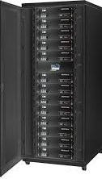
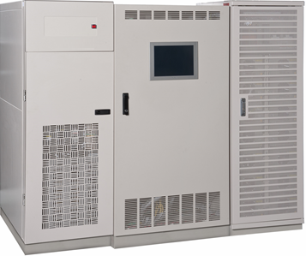
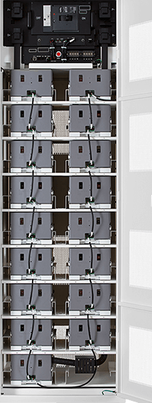
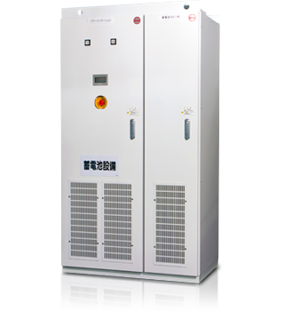
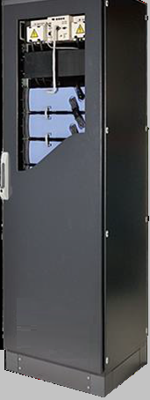
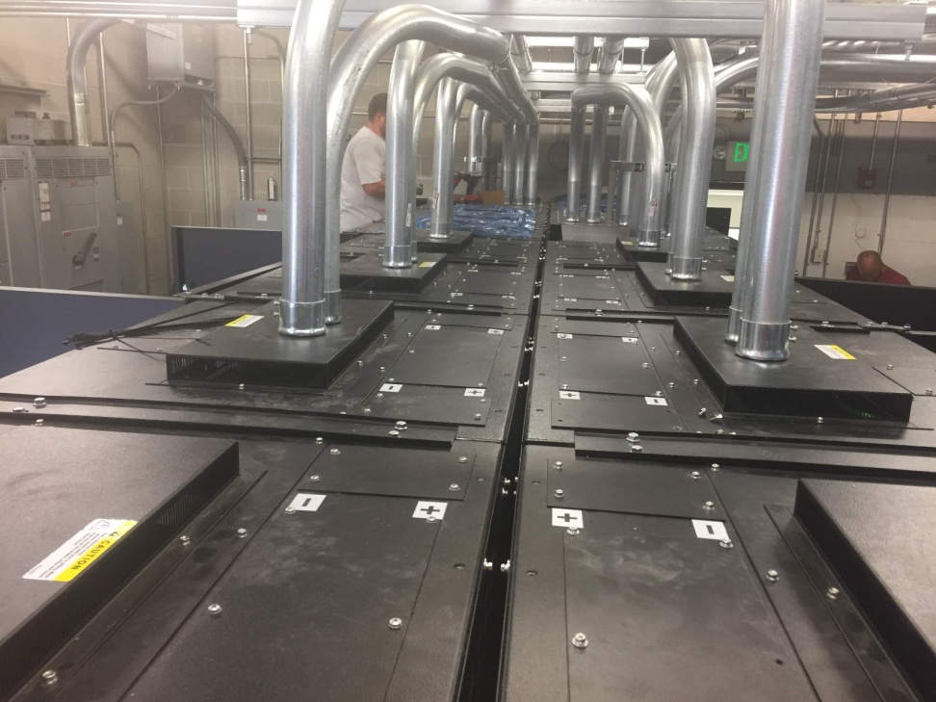
NEMA 1, 3R, 4X CABINETS
LITHIUM ION - BATTERY CABINETS
TOP ENTRY
HINGED FRONT DOOR
SEISMIC / NON-SEISMIC
Notes:
Nearly all of the 48 VDC, 120 VDC, 240 VDC, 360 VDC and 480VDC systems we have seen are

Slide 37
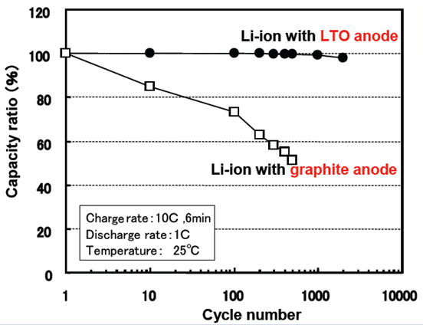
Lithium ION Battery Technology- End of Life
Aging Mechanisms: | Resulting Symptom
Intercalation (Natural) | Parasitic chemical reactions that prevent the lithium ions from populating the interstices of the active materials. Conductivity of the battery is gradually reduced as this occurs.
Repetitive Cycling (Natural) | Very gradual decline of BOL capacity.
Notes:
Note that we are strictly talking about the actual battery “cell” in this slide. We will not bring the electronics for monitoring, control, communication, or protection into this discussion at this time.
According to the Lithium ion battery manufacturers, as the battery ages (in a UPS application), there are negligible amount of chemical/electrolytic failure modes. The cell does not degrade significantly even past 20,000 cycles (although it drops to 80% BOL at around 17,000 cycles). Cross-sectional microscopic electro-lithography (based observations) vouches for our claims.
SCiB LTO does have natural aging just extremely slowly (as compared to other li-ion chemistries as mentioned above).

Slide 38
Lithium ION Battery Technology- End of Life
Premature Aging Mechanisms: | Resulting Symptom
Internal Overheating | Removal of the cell from the string. Venting of the cell
Cell Imbalance (Overcharge/overdischarge | Imbalance of cell voltage levels can cause the cells to age at different rates and affect the internal cell temperature. Improper sizing can also cause similar symptoms.
Lithium Plating | Results from too deep of a discharge with too fast of a recharge repetitively, When charged at too low of a temperature.
Dendrite/Lithium Deposition | Internal short circuit of a cell
Active Material Instability | Overtemperature resulting in disconnection
Notes:
Note that we are strictly talking about the actual battery “cell” in this slide. We will not bring the electronics for monitoring, control, communication, or protection into this discussion at this time.
According to Toshiba, as the battery ages (in a UPS application), there are negligible amount of chemical/electrolytic failure modes. The cell does not degrade significantly even past 20,000 cycles (although it drops to 80% BOL at around 17,000 cycles). Cross-sectional microscopic electro-lithography (based observations) vouches for our claims.
SCiB LTO does have natural aging just extremely slowly (as compared to other li-ion chemistries as mentioned above).

Slide 39
Lithium ION Battery Technology- Cabinetized Systems
Cabinetized Systems:
Cabinetry | Typically 90” (2286 mm) Height
 | Multi-string cabinet (offers redundancy) Single String cabinet (no redundancy) Disconnect per string Disconnect per cabinet Seismic rated per IFC 1206.2.4
 | Components: Battery monitoring/alarm notification system Battery management system System communication module Battery modules Battery DC disconnect
 | NEMA1 (IP20), NEMA3R (IP54) or Higher
Electronics | Hardened electronics
 | Redundant monitoring (Not typical. Most manufacturers operate without the communications interface.)

Slide 40
Lithium ION Battery Technology- Safety Concerns
Predominant Safety Concerns: | Remedy within the system:
Over-temperature | Cell, module, and string level protection
Over-Voltage | String level DC Disconnect, but still able to charge
Over-Discharge | Module level disconnect from load at 2.5 vpc, but continues to charge
Thermal Runaway | Alarm at 55⁰ C, Charge termination at 70⁰C
Moisture Intrusion | Humidity and moisture control
Cell Rupture (physical) | Containment within the module
Fire Propagation / Containment | Fire Suppression. Notification, clearances, testing per UL9540A and UL9540, Noncombustible Cabinets IFC 608
Communication Failure | Redundant real time communication modules, if N+1
Remote Comm Failure | Does not affect the module and inter-string communications.
Battery Management System Failure | Autonomy, optional redundancy in BMS
Charge Control Failure | Disconnection at the string level, module level and system level
Notes:
These are the items feared the most by the different OEMS. The temperature at which manufacturers disconnect varies from manufacturer to manufacturer, but most disconnect from the charging source between 65 and 70 ⁰C.
Safety is mitigated with considerable controls and status monitoring.

Slide 41
Lithium ION Battery Technology- BMS SAFETY
CERTIFICATION | Description
UL 9540; Article 706 of NFPA 70, (Also 9540A) | * Environmental Tests, Electrical Tests, Mechanical Tests, and 9540A for test methods for Thermal Runaway Fire Propagation.
UL 1973 | Materials, Enclosures, Safety Analysis, Safety Controls, Bonding, Insulation, Spacings, Grounding…Fire Test
IEC 61508 | Functional safety of electrical/electronic / Programmable electronic safety-related systems
IEC 62040-1 | Uninterruptible Power Systems (UPS) Safety Requirements
IEC 62040-2 | Uninterruptible Power Systems (UPS) Electromagnetic Compatibility Requirements
IEC 62040-3 | Uninterruptible Power Systems (UPS) Environmental Aspects
IEEE P2686 | Recommended Practice for Battery Management Systems in Energy Storage Applications
FCC 47 CFR Part 15 Subpart B Class A | FCC EMC Conformity (Unintentional Radiators)
FM DS 5-33 | Recommendations for construction, location, fire protection, electrical system protection and design of LIB ESS
Notes:
References presentation by UL: https://share.ansi.org/Shared%20Documents/Standards%20Activities/International%20Standardization/Regional/Staff/LMM/US-Africa-CESP/CESP%20Kenya%202018/Presentations/UL%20Presentation.pdf
One of the important aspects of UL 1973 is the Fire testing:
Internal Fire Test Proposed Revisions • Revised name of test to “Single Cell Failure Tolerance” • Divide the test into two methods: • Lithium ion method • Other technology method (applies to solid state lithium metal, sodium beta, lead acid batteries) • Both methods are single cell failure to determine if there is propagation outside of the DUT enclosure • Addition of details on cell failure methods in new Appendix F • Test is essentially a failure of a single cell to determine if there is propagation. (Pass fail criteria: no explosion and no fire propagation outside of the enclosure.)

Slide 42
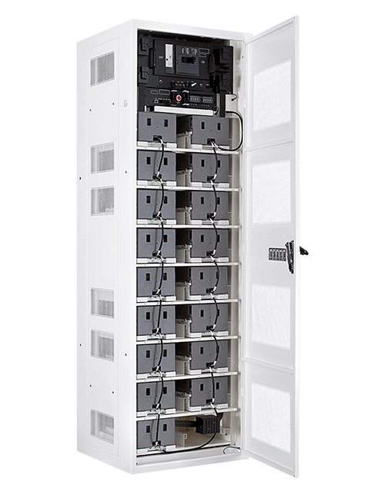

Lithium ION Battery Technology- Cabinetized Systems
How Safe are these LION systems:
Cabinetry | Each cell has the ability to be removed from the DC bus without impacting operation of the others (cell-level disconnecting means)
 | Cell level safety testing to UL1642, 1973, 9540
 | Each cell is protected from: Overcurrent Over-voltage Over-temperature
 | Each cell is monitored for: Impedance, Voltage, Temperature, Current.
 | Each module has overcurrent protection and microprocessor controlled monitoring UL 1973
 | Noncombustible cabinet/ enclosure IFC 608.4.2
 | NEMA3R (IP54) or Higher
Electronics | Hardened electronics for control, supervisory and monitoring UL 1998 and IEC 61000-6-2
 | Redundant supervisory monitoring + dry contacts
Enables cell “balancing”.
Notes:
Most of the manufacturers provide for several levels of protection:
Cell Level
Module Level
String Level
The UL 9540 certifications pertain for fire detection and suppression pre NFPA 550 and NFPA 551 , safety analysis and control systems, (ie. Remote controls cannot override local controls and systems must have a means to disconnect from remote control…)
UL 1973 is the standard for stationary power for SAFETY BATTERIES including railand substations.

Slide 43
Lithium ION Battery Technology- Shipping
Shipping Requirements:
Each cell / module must ship in its own carton (Shipped loose for field installation)
Replacement Cells are carrier specific for shipping and handling
UN classification (spent) ship as Class 9
Requires 3-6 months for air cargo approval
CDL Hazmat licensed driver required for transport
Certified to UN/DOT 38.3
Packing per 49 CFR 173.185: | Lithium Ion Battery | Lithium Metal Battery
Stand Alone | (P.I. 965) UN 3480 Class 9 group 2 | (P.I. 968) UN 3090
Packed w/ Eqt but not installed in equipment | (P.I. 966) UN 3481 | (P.I. 969) UN 3091
Contained in Equipment | (P.I. 967) UN 3481 | (P.I. 970) UN 3091
Notes:
Lithium Batteries must be certified to UN/DOT 38.3 requirements:
T1 – Altitude Simulation (Primary and Secondary Cells and Batteries)
T2 – Thermal Test (Primary and Secondary Cells and Batteries)
T3 – Vibration (Primary and Secondary Cells and Batteries)
T4 – Shock (Primary and Secondary Cells and Batteries)
T5 – External Short Circuit (Primary and Secondary Cells and Batteries)
T6 – Impact (Primary and Secondary Cells)
T7 – Overcharge (Secondary Batteries)
T8 – Forced Discharge (Primary and Secondary Cells)

Slide 44
Chemistry
CHEMISTRY: (LITHIUM IRON PHOSPATE) Li₄Ti₅O₁₂
_{2-Part Reaction:}
LiFePO₄ ←→ FePO₄ ← Electrolyte → Li + e- + C ←→ LiC₅
Cathode (+ electrode) Anode (- electrode)
Aluminum Current Collector Copper Current Collector
→ _{Left to right is Charging.}
←_{Right to Left is Discharging.}
_{CELL VOLTAGE:}
3.4 VDC per cell
Ethylene Carbonate (EC) /Dimethylcarbonate (DMC)
Larger voltage per cell means fewer cells required for the same output power.

Slide 45
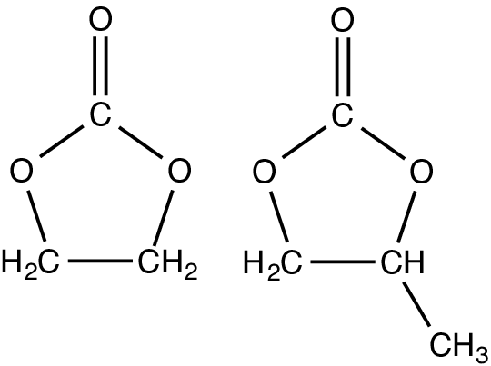
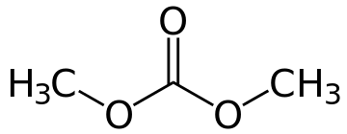
Chemistry
CHEMISTRY: (LITHIUM IRON PHOSPATE) LiFePO₄
_{2-Part Reaction:}
LiFePO₄ ←→ FePO₄ ← Electrolyte → Li + e- + C ←→ LiC₅
Cathode (+ electrode) Anode (- electrode)
_{Left to right is Charging.}
_{Right to Left is Discharging.}
_{Carbon}
_{Electrolyte:}
Ethylene Carbonate (EC) /Dimethylcarbonate (DMC)
Ethylene Carbonate:
Dimethylcarbonate:
Notes:
This slide depicts the chemistry involved in creating voltage at the battery terminals for LiFePO4. This chemistry uses ethylene carbonate and dimethylcarbonate as the electrolyte. The electrolyte is essentially a salt.
The important thing to note on this slide is the red circles on this slide. We have circled all of the places in this slide that use “carbon” in this chemistry. Just make mental not of the following element on this slide “C” stands for Carbon. We will actually come back to this slide when we start discussing safety. Graphite is used by a lot of manufactures because though it is soft and malleable, it is chemically very stable and can withstand the deposition and removal of lithium ions from its interstices with very little esparity.

Slide 46
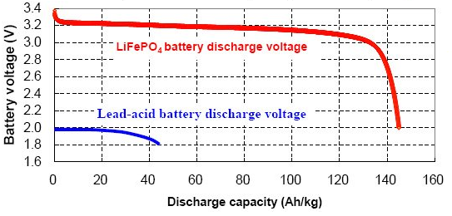
Chemistry
CHEMISTRY: (LITHIUM IRON PHOSPATE) LiFePO₄
_{Nominal Voltage:}
The average voltage is where the flat part of the curve intersects the green line. This is the “nominal cell voltage” @ 3.2 vpc.
Notes:
In establishing a “Nominal Voltage” the manufacturers will use the “Discharge curve of voltage on the Y-axis and Capacity /Kg on the X-axis. The tope curve shows how the LiFePO4 compares to a high-rated sealed lead acid battery. The lead acid battery curve is more round, while the LiFePO4 is very flat through the largest part of the discharge curve, and then drops off rapidly. If we draw a straight line through the flat part of this curve, the intersection point established the average or “mean” voltage on this curve. This intersection point is where the “Nominal” or nameplate rated voltage of the cell comes from.
Reference: Chart reproduced from

Slide 47
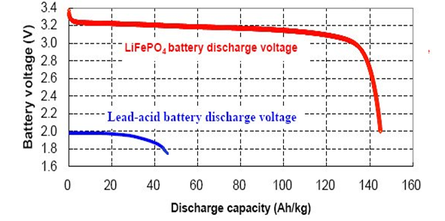
Chemistry
CHEMISTRY: (LITHIUM IRON PHOSPATE) LiFePO₄
The capacity per kilogram is nearly 3.5 times that of lead acid high rate batteries.
Difference in discharge
capacity/kg
Notes:
For a short duration discharge, meaning a high rate discharge, the graph above illustrates the difference in capacity per kg for a traditional high rate UPS battery and a liFePO4 battery. The X-axis is labeled Ah/kg. The curves are actually voltage and shows that the voltage delivered by the battery is not constant. In fact, the battery voltage declines as the battery discharges. This decline in voltage not only affects power, but also energy density.
To get the same capacity during this discharge period, I would need 4 parallel strings of this particular lead acid batteries.
Question: Will that difference in number of strings be realized when I consider a real application? Yes. The impact is in floor loading.
Let’s find out.

Slide 48
Chemistry
CHEMISTRY: (LITHIUM IRON PHOSPATE) LiFePO₄
End of discharge voltage of @2 vpc
Specification limit for EODV is different for lead acid, nickel cadmium, and LION.
End of discharge voltage of @ 1.75 or 1.68vpc
Difference in discharge
capacity/kg
Notes:
This is the exact same slide as before, except we are now focused on the EODV.
Notice the difference in EODV for each chemistry:
For lead acid, we use 1.75 vpc for long duration discharges, and 1.68 vpc for fast discharges. For lithium ion, most manufacturers will terminate discharge at 2.0 vpc. Th

Slide 49
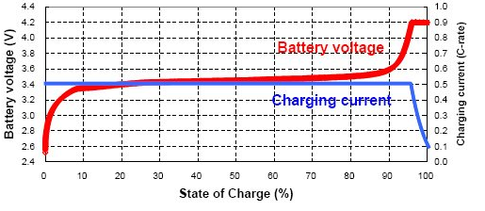
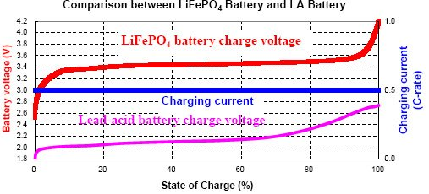
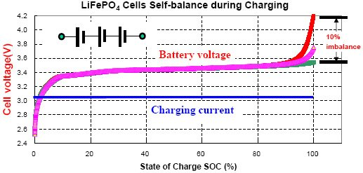
Chemistry
CHEMISTRY: (LITHIUM IRON PHOSPATE) LiFePO₄
Overcharge tolerance is better on LiFePO4 than with LTO/LiCoO2
Notes:
2. Large overcharge tolerance and safer performance
A LiCoO2 battery has a very narrow overcharge tolerance, about 0.1V over the 4.2V per cell charging voltage plateau, which also the upper limit of the charge voltage. Continuous charging over 4.3V would either damage the battery performance, such as cycle life, or result in fire or explosion.
A LiFePO4 battery has a much wider overcharge tolerance of about 0.7V from its charging voltage plateau of 3.5V per cell. When measured with a differential scanning calorimeter (DSC) the exothermic heat of the chemical reaction with electrolyte after overcharge is only 90 Joules/gram for LiFePO4 versus 1600 J/g for LiCoO2 . The greater the exothermic heat, the more vigorous the fire or explosion that can happen when the battery is abused.
A LiFePO4 battery can be safely overcharged to 4.2 volts per cell, but higher voltages will start to break down the organic electrolytes. Nevertheless, it is common to charge a 12 volt a 4-cell series pack with a lead acid battery charger. The maximum voltage of these chargers, whether AC powered, or using a car's alternator, is 14.4 volts. This works fine, but lead acid chargers will lower their voltage to 13.8 volts for the float charge, and so will usually terminate before the LiFe pack is at 100%. For this reason a special LiFe charger is required to reliably get to 100% capacity.
Due to the added safety factor, these packs are preferred for large capacity and high power applications. From the viewpoint of large overcharge tolerance and safety performance, a LiFePO4 battery is similar to a lead-acid battery.

Slide 50
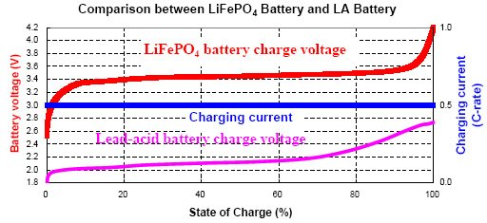
Chemistry
CHEMISTRY: (LITHIUM IRON PHOSPATE) LiFePO₄
Charging Voltage per cell is different than the lead acid batteries as you can see from the chart. The charging voltage of most chargers and UPS modules is adjustable. Care must be taken to ensure that the charging voltage of the equipment is taken into consideration for battery sizing purposes.
Notes:
2. Large overcharge tolerance and safer performance
A LiCoO2 battery has a very narrow overcharge tolerance, about 0.1V over the 4.2V per cell charging voltage plateau, which also the upper limit of the charge voltage. Continuous charging over 4.3V would either damage the battery performance, such as cycle life, or result in fire or explosion.
A LiFePO4 battery has a much wider overcharge tolerance of about 0.7V from its charging voltage plateau of 3.5V per cell. When measured with a differential scanning calorimeter (DSC) the exothermic heat of the chemical reaction with electrolyte after overcharge is only 90 Joules/gram for LiFePO4 versus 1600 J/g for LiCoO2 . The greater the exothermic heat, the more vigorous the fire or explosion that can happen when the battery is abused.
A LiFePO4 battery can be safely overcharged to 4.2 volts per cell, but higher voltages will start to break down the organic electrolytes. Nevertheless, it is common to charge a 12 volt a 4-cell series pack with a lead acid battery charger. The maximum voltage of these chargers, whether AC powered, or using a car's alternator, is 14.4 volts. This works fine, but lead acid chargers will lower their voltage to 13.8 volts for the float charge, and so will usually terminate before the LiFe pack is at 100%. For this reason a special LiFe charger is required to reliably get to 100% capacity.
Due to the added safety factor, these packs are preferred for large capacity and high power applications. From the viewpoint of large overcharge tolerance and safety performance, a LiFePO4 battery is similar to a lead-acid battery.

Slide 51
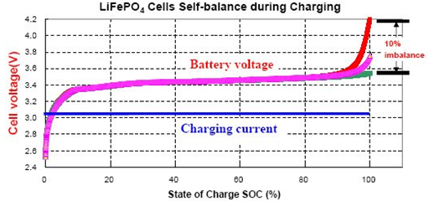
Chemistry
CHEMISTRY: (LITHIUM IRON PHOSPATE) LiFePO₄
What is “self-balancing”?
The profile above shows that at about 90% state of charge, the batteries will have some differences in the time at which they reach the 100% state of charge.
Notes:
2. Large overcharge tolerance and safer performance
Once a battery has reached a full state of charge, charging current injected into the battery is considered “overcharge”.
A LiCoO2 battery has a very narrow overcharge tolerance, about 0.1V over the 4.2V per cell charging voltage plateau, which also the upper limit of the charge voltage. Continuous charging over 4.3V would either damage the battery performance, such as cycle life, or result in fire or explosion.
A LiFePO4 battery has a much wider overcharge tolerance of about 0.7V from its charging voltage plateau of 3.5V per cell. When measured with a differential scanning calorimeter (DSC) the exothermic heat of the chemical reaction with electrolyte after overcharge is only 90 Joules/gram for LiFePO4 versus 1600 J/g for LiCoO2 . The greater the exothermic heat, the more vigorous the fire or explosion that can happen when the battery is abused.
A LiFePO4 battery can be safely overcharged to 4.2 volts per cell, but higher voltages will start to break down the organic electrolytes. Nevertheless, it is common to charge a 12 volt a 4-cell series pack with a lead acid battery charger. The maximum voltage of these chargers, whether AC powered, or using a car's alternator, is 14.4 volts. This works fine, but lead acid chargers will lower their voltage to 13.8 volts for the float charge, and so will usually terminate before the LiFe pack is at 100%. For this reason a special LiFe charger is required to reliably get to 100% capacity.
Due to the added safety factor, these packs are preferred for large capacity and high power applications. From the viewpoint of large overcharge tolerance and safety performance, a LiFePO4 battery is similar to a lead-acid battery.

Slide 52
Chemistry- LTO
CHEMISTRY: (LITHIUM TITANATE OXIDE ANODE) Li₄Ti₅O₁₂
Chemical Formula:
Li₄Ti₅O₁₂ + 6LiCoO₂ ←→ Li₇Ti₅O₁₂ + 6Li_{0.5}CoO₂
(Anode) (Cathode) (Anode) (Cathode)
Aluminum Current Collector Copper Current Collector
Cell Potential: 2.1 VDC per cell
(patented)
Li = Lithium
Co = Cobalt
Ti = Titanium
O = Oxygen
→ Left to right is Charging.
← Right to Left is Discharging.
Notes:
The “Ti” in this formula stands for Titanium. The “Co” in this slide stands for Cobalt. The “Li” stands for Lithium, and the “O” in this slide stands for Oxygen.
Electrolyte for this cell type consists of lithium ions dissolved in organic solvents.
You will not that there is no elemental carbon on this slide, so no carbon participates in the reaction for developing the voltage at the battery terminals. NOTE: Notice the absence of the elemental carbon in this reaction. There is no carbon participating in the reaction. Again, this is important when we start talking about fire safety later in this presentation.

Slide 53





Chemistry- (LITHIUM TITANATE OXIDE ANODE)
CHEMISTRY: (LITHIUM TITANATE OXIDE ANODE) Li₄Ti₅O₁₂
Chemical Formula:
Li₄Ti₅O₁₂ + 6LiCoO₂ ←→ Li₇Ti₅O₁₂ + 6Li_{0.5}CoO₂
(Anode) (Cathode)
Cell Potential: 2.1 VDC per cell
(patented)
Li = Lithium
Co = Cobalt
Ti = Titanium
O = Oxygen
Noteworthy: Absence of Carbon
Notes:
The “Ti” in this formula stands for Titanium. The “Co” in this slide stands for Cobalt. The “Li” stands for Lithium, and the “O” in this slide stands for Oxygen.
You will not that there is no elemental carbon on this slide, so no carbon participates in the reaction for developing the voltage at the battery terminals. NOTE: Notice the absence of the elemental carbon in this reaction. There is no carbon participating in the reaction.

Slide 54
LITHIUM BATTERY TRAINING- Best Practice Standards
2018 IFC CHAPTER | SUBJECT (CHANGES)
7 | Fire and smoke protection features
8 | Interior finish, decoration materials and furnishings
9 | Fire protective and life safety systems
10 | Means of egress
12 | Energy Systems (1206.2 Stationary Storage Battery Systems)
33 | Fire safety during construction and demolition
Notes:
Chapter 12 Energy Systems. Chapter 12 was added to address the current energy systems
found in the IFC. It introduces a wide range of systems that generate and store energy in, on and
adjacent to buildings and facilities. The expansion of such energy systems is related to meeting
today’s energy, environmental and economic challenges. Ensuring appropriate criteria to address
the safety of such systems in building and fire codes is an important part of protecting the public at
large, building occupants and emergency responders. Previously, requirements for energy systems,
such as standby power systems, PV systems and stationary battery systems, were scattered about
in various locations in Chapter 6, which addresses building services and systems. However, with the
addition of fuel cells and capacitor energy storage systems to the IFC, a chapter dedicated to such
related issues needed to be created. This chapter provides an appropriate location for the addition
of future energy systems

Slide 55
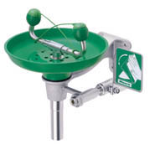
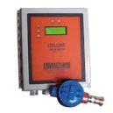

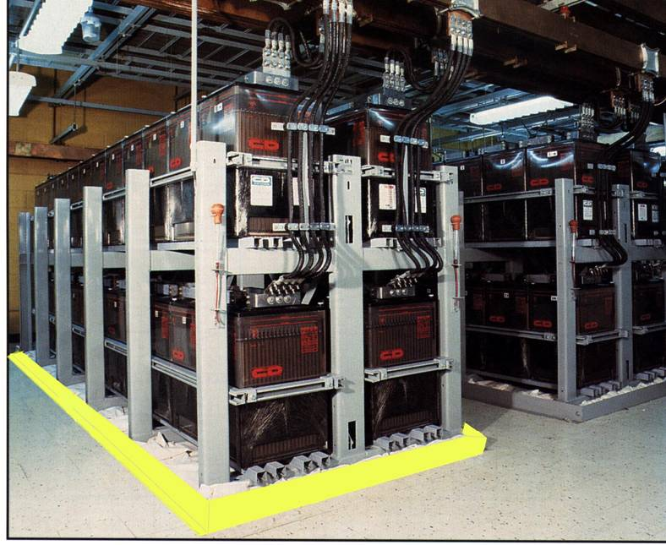






BATTERY ROOM DESIGN- IEEE and NFPA Guidelines
Battery Room Considerations: | Lithium Ion
Charger/s * | Single only
Spill containment | N/A
Spill Neutralization (5.0-7.0 PH) | N/A
PPE | Yes (Electrical)
Eyewash station (15 min flush Minimum) | N/A
Gas Detection & Alarm | YES
Ventilation | N/A
Safety Signage | Yes
Battery Disconnect | Yes
Battery cabling | Special
Access/Egress | Yes/ Location Dependent
Fire Suppression * | Yes
Fire Protective Clearances * | Yes
Eyewash
H2 Monitor
PPE
Spill barriers
Spill Response
2018 NFPA 52.3.2.7-8
2018 NFPA 52.3.2.7-8
Signage
Notes:
Suppression:
2015 editions did not explicitly require suppression
2018 NFPA 52.3.2.7-8 required for all battery spaced w/ exceptions for telecommunication installations
Gas Detection
Alarming for 25% of the lower flammability level of gas as well as 50% of the IDLH (immediately dangerous to life or health) for toxic or highly toxic gases.
Must have visible and audible alarms in the battery room
Approved transmission to specific location
De-energizing of the battery rectified
Activation of the ventilation

Slide 56
BATTERY TECHNOLOGY – CODES AND REGULATIONS
IFC 608.1 (prior 2018) | Flooded Lead Acid | Flooded Nickel Cadmium | Valve Regulated Lead Acid | Lithium Ion | Lithium Metal Cells
Safety caps | Venting Caps (608.2.1) | Venting Caps (608.2.1) | Self sealing flame arresting caps (608.2.2) | N/A | N/A
Thermal Runaway Management | N/R | N/R | Required (608.3) | N/R | Required (608.3)
Spill Control | Required (608.5) | Required (608.5) | N/R | N/R | N/R
Neutralization | Required (608.5.1) | Required (608.5.1) | Required (608.5.2) | N/R | N/R
Ventilation | Required (608.6.1 and 6.08.6.2) | Required (608.6.1 and 6.08.6.2) | Required (608.6.1 and 6.08.6.2) | N/R | N/R
Signage | Required (608.7) | Required (608.7) | Required (608.7) | Required (608.7) | Required (608.7)
Seismic Protection | Required (608.8) | Required (608.8) | Required (608.8) | Required (608.8) | Required (608.8)
Smoke Detection | Required (608.9) | Required (608.9) | Required (608.9) | Required (608.9) | Required (608.9)
Notes:
Reference:

Slide 57

BATTERY TECHNOLOGY – Lithium Battery Room Requirements
IFC 2018 chapter 12 and NFPA-1 chapter 52 ADDITIONAL RESTRICTIONS FOR LION BATTERIES)
1. Must have means of disconnect from charging source on overtemp.
2. Must be installed below 75 feet from ground level.
3. Must be installed higher than 30 feet below ground. 506.4 and 506.5
4. High Hazard Classification required for exceeding MAQ.
5. Separation of 36” between arrays of batteries and/or other equipment that is not 1-hour fire rated.
6. Additional permitting requirements for operation as well as location within the interior of a building. Section 506.4, 506.5, 508.2.3, 508.3.2, 508.4.2
Notes:
The biggest changes to the Fire Codes happened in 2018 and mostly to address the flammability and potential volatility of emerging battery technologies. This data was provided in IFC chapter 12 and NFPA-1 chapter 52.
Photo courtesy of Times of India (Beaumonde Towers in Worli) June 13, 2018.

Slide 58
BATTERY TECHNOLOGY TRAINING – Lithium Battery Room Requirements
IFC 2018 chapter 1206.2 and NFPA-1 chapter 52 MAXIMUM ALLOWABLE QUANTITIES (MAQ)
BATTERY TECHNOLOGY | Maximum Allowable Quantity | Group H Occupancy
Lead Acid (All Types) | Unlimited | N/A
Nickel Cadmium | Unlimited | N/A
Lithium, (All Types) | 600 kWh | Group H-2
Sodium, (All Types) | 600 kWh | Group H-2
Flow Batteries | 600 kWh | Group H-2
Other Batteries | 200 kWh | Group H-2 *
Exceeding these levels means the facility has to be reclassified as a “High Hazard Occupancy”.
International Fire Code (IFC)- developed and updated by review of proposed changes submitted by code enforcement officials, industry representatives, design professionals and other interested parties.
Notes:
The biggest changes to the Fire Codes happened in 2018 and mostly to address the flammability and potential volatility of emerging battery technologies. This data was provided in IFC chapter 12 and NFPA-1 chapter 52. Group H-2 applies as “deflagration hazard or hazard from accelerated burning.
Risk Mitigation and Failure mode analysis and AHJ approval is required for installations over the Maximum Accepted Quantities
Storage batteries, prepackaged stationary storage battery systems and pre-engineered stationary storage battery systems are required to be segregated into stationary battery arrays (strings) not exceeding 50 KWh (180 Mega joules) each. Exceptions include:
Lead acid and nickel cadmium storage battery arrays
Listed pre-engineered stationary storage battery systems and prepackaged stationary storage battery systems shall not exceed 250 KWh (900 Mega joules) each
The fire code official is authorized to approve listed pre-engineered and prepackaged battery arrays with larger capacities or smaller battery array spacing if large scale fire and fault condition testing conducted or witnessed and reported by an approved testing laboratory is provided showing that a fire involving one array will not propagate to an adjacent array, and be contained within the room for a duration equal to the fire resistance rating of the room separation specified in Table 509 of the International Building Code
Flow batteries use liquid electrolyte to store energy….vanadium-redox, zinc-bromine, iron-chromate

Slide 59
BATTERY TECHNOLOGY TRAINING – Lithium Battery Room Requirements
IFC 2018 1206.2 and NFPA-1 MAXIMUM ALLOWABLE QUANTITIES (MAQ)
BATTERY TECHNOLOGY | Maximum Allowable Quantity | Group H Occupancy
Lithium, (All Types) | 600 kWh | Group H-2
Example: 750 KVA/750 KW UPS for 15 minutes (no aging factor, no design margin, no temperature derating applied). 750 kW x 15 min x 1 hour = 187.5 KWh 60 minutes 600 KWh / 187.5 kWh = 3.2 Maximum # of UPS Modules: 3
ARCHITECTURAL CONSIDERATIONS AND FIRE PROTECTIVE MEASURES OF GROUP H-2 OCCUPANCY AND FOR MAQ MUST BE CONSIDERED. The AHJ can determine the requirement to be Group H-2 if the battery represents a significant fire hazard or thermal runaway.
Notes:
If 600 kWh is the Maximum Allowable Quantity allowed per IFC and NFPA, then we must be cognizant of how this impacts the battery room designs for the lithium ion batteries. Remember in the previous slide, there was no MAQ for either nickel cadmium batteries or for lead acid batteries.
If we multiply the battery capacity for a very common size of a UPS (750 KWb), and we intend the run-time to be 15 minutes to the EODV, then the formula shown in the rectangle applies. We convert the 15 minutes to hours and multiply the discharge time by the KW rating.

Slide 60
BATTERY TECHNOLOGY TRAINING – Lithium Battery Room Requirements
IFC 2018 chapter 12 and NFPA-1 chapter 52 MAXIMUM ALLOWABLE QUANTITIES (MAQ) FOR A SINGLE STRING/ARRAY
BATTERY TECHNOLOGY | Maximum String Allowable Quantity
Lead Acid (All Types) | 70 KWh
Nickel Cadmium | 70 KWh
Lithium, (All Types) | 20 KWh
Sodium, (All Types) | 20 KWh
Flow Batteries | 20 KWh
Other Batteries | 10 KWh
Exceeding these levels means the facility has to be reclassified as a “High Hazard Occupancy”.
International Fire Code (IFC)- developed and updated by review of proposed changes submitted by code enforcement officials, industry representatives, design professionals and other interested parties.
Notes:
The codes additionally require a limit for the capacity allowed as a single string or array per the Table above. This data was provided in IFC chapter 12 and NFPA-1 chapter 52.

Slide 61

REDOX FLOW BATTERIES
FLOW BATTERY – LARGE POWER
Ideal:
PV
Wind
Regen
Standby
Prime Power
Notes:
Used for milliseconds of storage for typically sub-cycle voltage flicker events. This photo is courtesy of presentation Korba Battery Research and Development Association of Korea.
Flow batteries use liquid electrolyte to store energy….vanadium-redox, zinc-bromine, iron-chromate

Slide 62
Excellent benefits over single strings of VLA or NICAD
Excellent repetitive Cycling
Excellent high & low temperature operation
Rapid Recharge capability
Built-in Charging Regulation
Very compact and light weight for short duration discharges
Very predictable and stable life and cycle life
12-15 year “Maintenance Free” operation
Built-in Thermal Runaway Control
Cell and string level Battery Monitoring (standard)
Superior Shelf Life
LITHIUM ION BATTERY – SUMMARY
BENEFITS:

Slide 63





Single String VLA or NICAD Replacement
Engine Generator Start
Switchgear/Process Control
Wind Turbine Energy Storage
Photovoltaic System Energy Storage
<5 Minute UPS Applications
Flicker and Voltage Control Applications
LITHIUM ION BATTERY – SUMMARY
BEST APPLICATIONS:

Slide 64


LITHIUM ION BATTERY TRAINING- LARGE BESS
Controller Functions:
• Charge/discharge, Balancing control
• SOC Target Control
• Active/ Reactive Power Controls
• Protection and Abnormality Detection
• DC Contactor Control
• Cell Balancing Control
Container Components:
• Integrated HVAC system / liquid cooling system
• Standard outdoor-rated container
• Modifiable racks based on capacity requirements
• Built-in fire alarm/suppression system
Max dimensions: 45’ L x 8’ D x 9.5’ T
PER NFPA 850 4.4.3.2: If 100’ from buildings, lot lines, public ways, storage, then remote installations can omit water supply and fire suppression if AHJ agrees.
Notes:
Paragraph 4.4.3.3 advises these outdoor system can’t be larger than 45’ x 8’ x 9.5 or they have to comply with indoor installation requirements.

Slide 65
LARGE POWER (BESS)
Super cycling and fast recharge
No Building Code Compliance
Excellent repetitive cycling
Excellent high temperature operation
Excellent low temperature operation
Very compact and light weight
Very predictable and stable life and cycle life
12-15 year maintenance free operation
Battery & cell monitoring is standard
LITHIUM ION BATTERY – LARGE POWER
Ideal:
PV
Wind
Regen
Standby
Transfer
18 MWh
Notes:
This photo is courtesy of presentation Korba Battery Research and Development Association of Korea, Shin-Yongin S/S

Slide 66

UTILITY GRID INTETERCONNECTION REQUIRES COMPLIANCE: p p
LITHIUM ION BATTERY – LARGE POWER
18 MWh
Notes:
Slide adapted from: https://share.ansi.org/Shared%20Documents/Standards%20Activities/International%20Standardization/Regional/Staff/LMM/US-Africa-CESP/CESP%20Kenya%202018/Presentations/UL%20Presentation.pdf
This testing requires testing for electrical function and compatibility:
Electrical Tests: • Functional Safety/reliability evaluation of Electronics • Normal Operations (temperature and check of component operating parameters under maximum loading) • Dielectric Voltage Withstand • Impulse • Equipment Grounding and Bonding • Insulation Resistance.
Environmental Tests: • Special Environment Installations • Outdoors installations subject to moisture exposure • Outdoor installation near marine environments • Installation in seismic environments
It also defines mechanical tests as follows:
Mechanical Tests: • Containment of Moving Parts • Over speed qualification • Faulted securement qualification • Blocked shaft qualification • Mechanical failure qualification • Leakage • Strength • Hydrostatic • Pneumatic

Slide 67


LITHIUM ION BATTERY – SUMMARY
LIMITATIONS:
FM, NFPA and IEEE practices are lagging for Station Power.
Charging Compatibility must be approved and/or certified by the manufacturer.
External System DC breaker may be required for systems of 3+ cabinets for EPO capability with UPS.
Manufacturers want compatibility for replacements.
Maximum allowable quantities affects Occupancy Classifications.
36” Clearance requirement all around.
Fire Suppression reqs keep changing.
Transport must be by certified DOT driver.
Sizing programs are not available to the public.
Higher purchase price.

Slide 68
LITHIUM ION BATTERY – SUMMARY
LIMITATIONS: Continued
Electronics required for battery management and monitoring are not as hardened for temperature extremes as the battery modules.
System capacity and physical size is restricted by the NFPA 850
Many manufacturers ship the batteries loose which means certified installation team has to be dispatched.

Slide 69

Battery Recharge Curve

Slide 70

Classical Thermal Runaway

